Slide 1


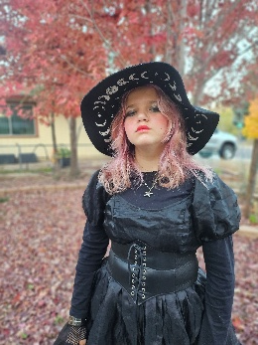
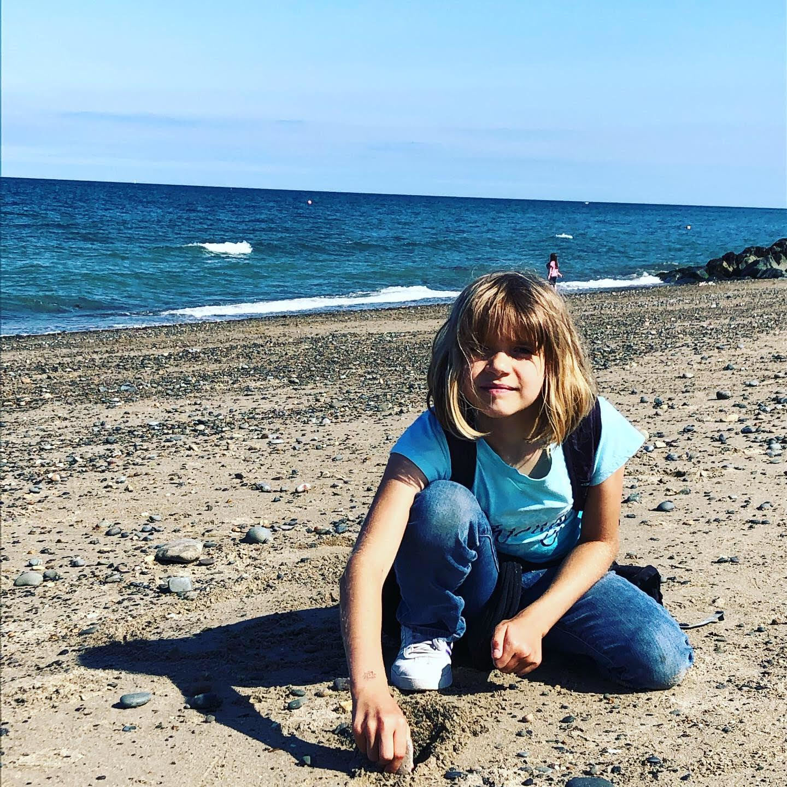
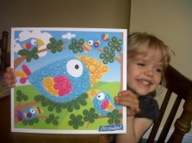
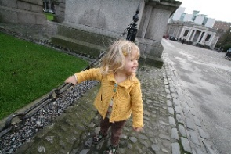
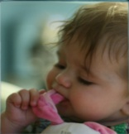
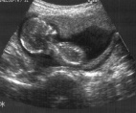
Preparing for Life at Age 14
Professor Orla Doyle
University College Dublin
23rd May 2025

Slide 2
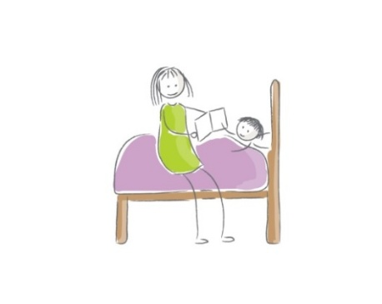
Background
Evidence-base used to justify investment in early childhood founded on a handful of preschool experiments from 1960’s/70’s (e.g. Perry Preschool; Abecedarian Program)
Results from these experiments have led to rollout of preschool programmes globally
Early childhood (0-3) most productive period for brain development
Environment & parental behaviour shapes children’s neurological processes (Cantor et al. 2019; Shonkoff 2010)
Intervening earlier in the lifecycle with parents may be a more effective strategy
The aim of the Preparing for Life study was to become a ‘Perry’ of the 21st century!

Slide 3
Preparing for Life Programme
Preparing for Life: One of first & longest running experimental early childhood intervention in Europe
Evidence of need: Children scoring below the norm on cognitive & socioemotional skills on school entry
Developed using a bottom-up approach: Community initiative of 28 community groups, service providers, & local representatives
Aim
Improve children’s skills by assisting parents in developing skills to prepare their children for school

Slide 4



Preparing for Life (2008-2015)
PFL Participants
233
Random Assignment
HIGH
LOW
€100 developmental toys annually & book packs
Enhanced pre-school
Public health workshops
Facilitated access to local services
Access to social events
5 Year home visiting programme
Triple P
Baby massage
€100 developmental toys annually & book packs
Enhanced pre-school
Public health workshops
Facilitated access to local service
Access to social events

Slide 5
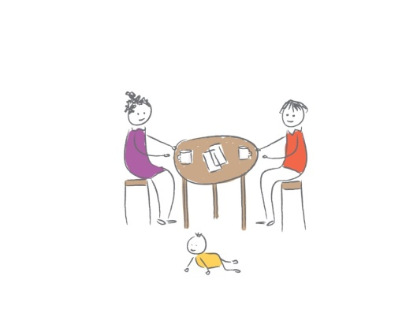
High Treatment
Home-visiting Programme
Timing: Pregnancy to school entry (age 4/5)
Treatment: Bi-monthly home-visits of ~1hr from a trained home visitor
Aim: Improve knowledge of child development and nurturing and encourage greater cognitive stimulation
Trained home visitors: Received six months training, and monthly supervision throughout the trial
Delivery methods: Role modelling, coaching, discussion, encouragement, and feedback, as well as directly interacting with the PFL child

Slide 6





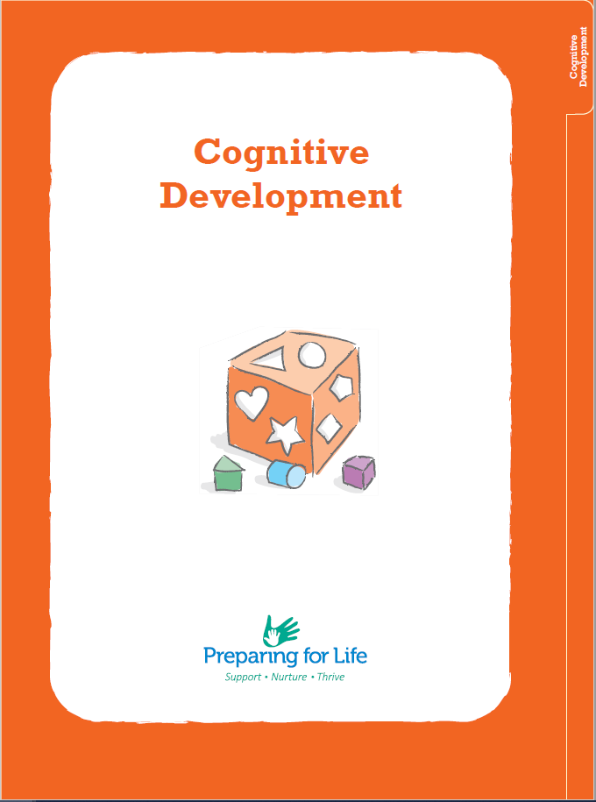


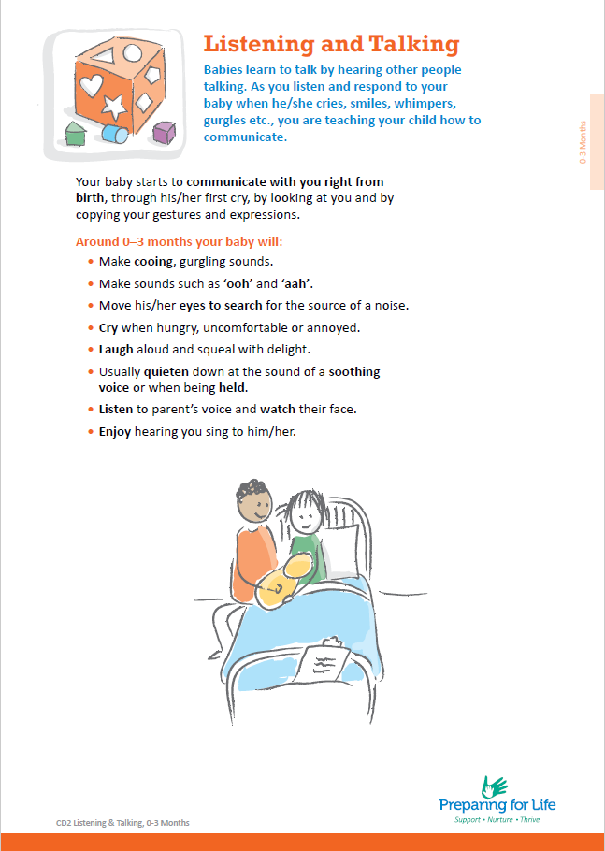
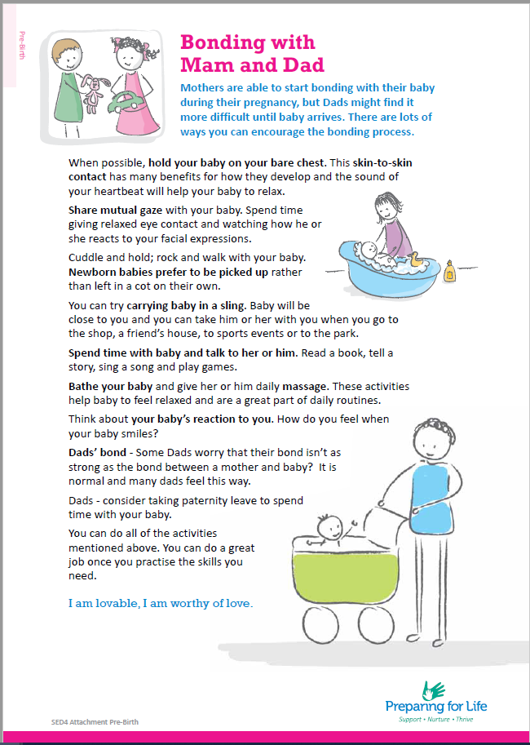
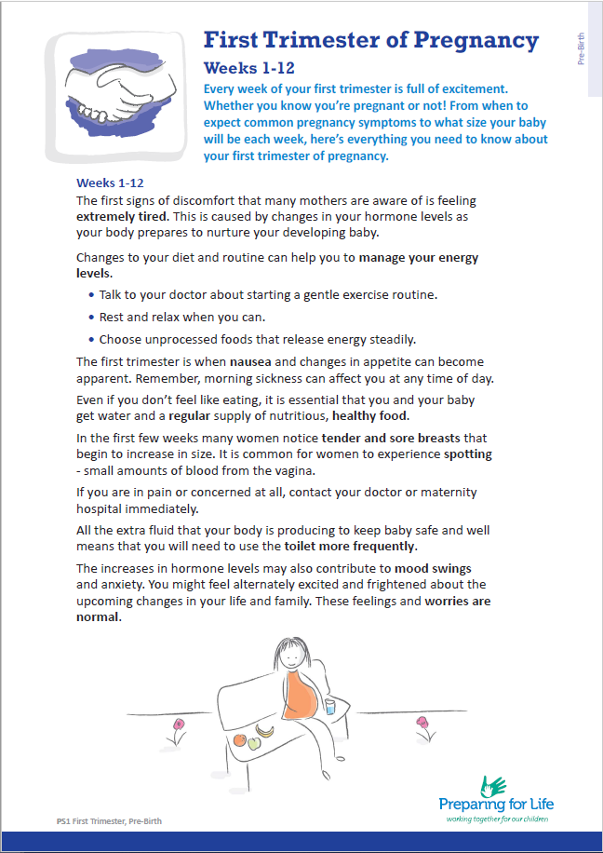


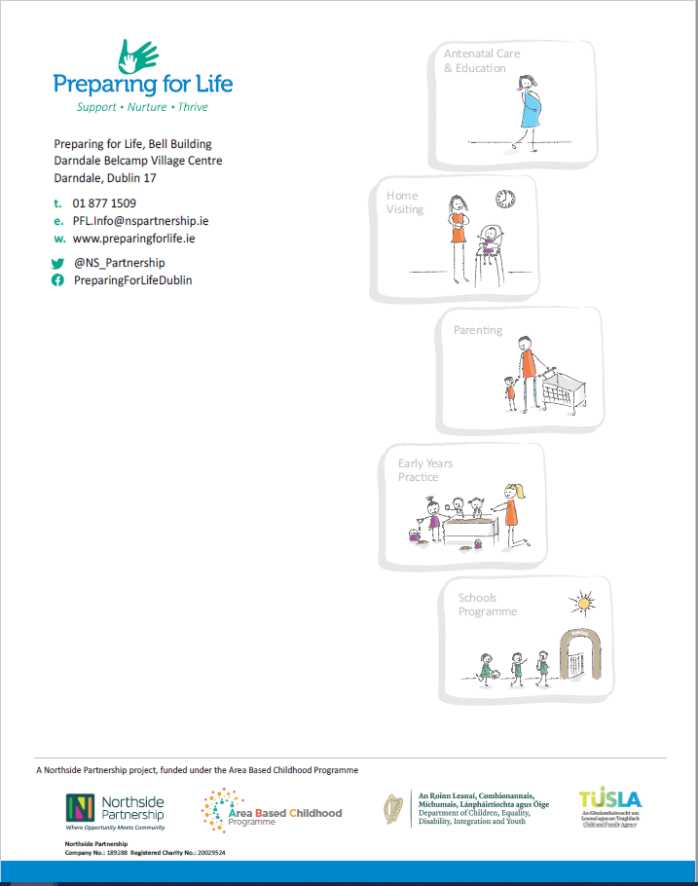
PFL Tip Sheets

Slide 7
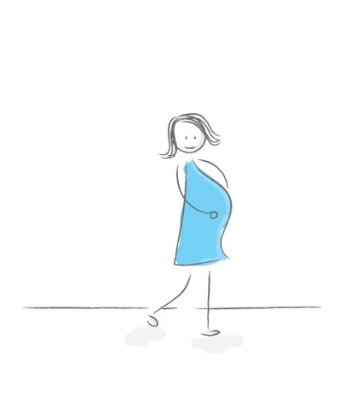
Study Design
Who could join PFL?
Pregnant women residing in PFL catchment area between 2008-2010
How many joined PFL?
233 women recruited in maternity hospitals & self-referral (52%)
How did randomisation work?
Randomly allocated 115 to High and 118 to Low treatment groups
No differences between groups on 92% baseline measures
How did we find out if PFL worked?
Collected 11 rounds of quantitative data (interviews, medical records, direct assessments) & 5 rounds qualitative data (focus groups etc.)

Slide 8
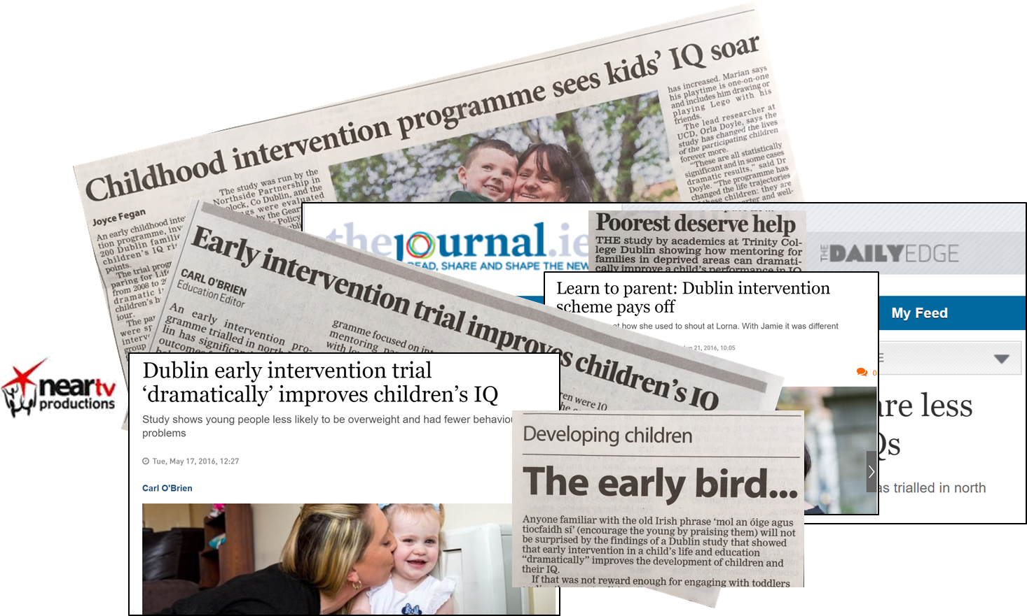


Series of 9 reports
Extensive media coverage
A body of 25+ published articles

Slide 9
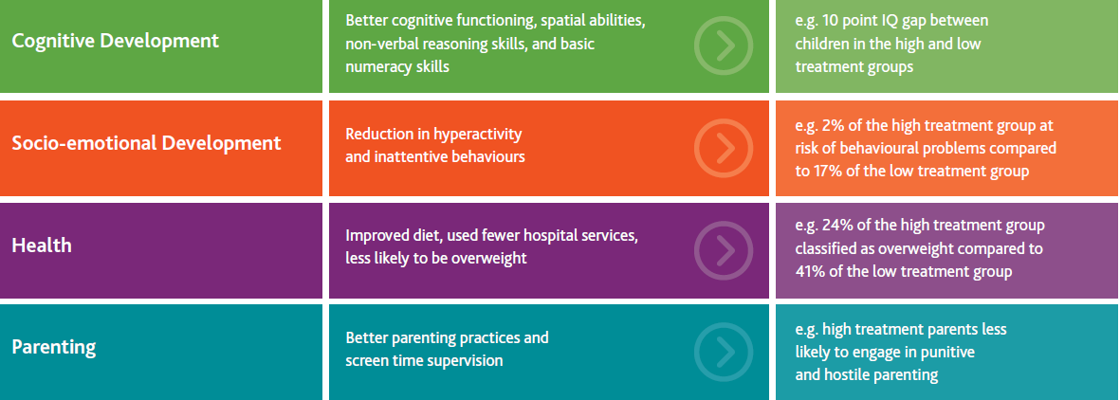
What did we find at Age 5?

Slide 10
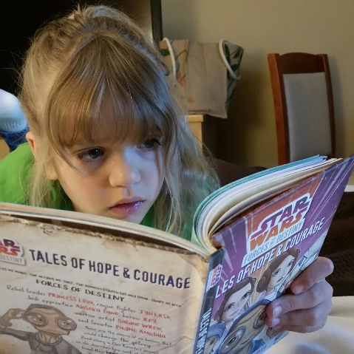
What did we find at Age 9?
PFL had a sizeable impact on cognitive skills and achievement tests 5 years after finishing the programme
Raised overall cognitive skills by 0.67SD & math/reading scores by 0.40-0.50SDs
No effect on socio-emotional outcomes
No effect on health outcomes
Doyle, O (2024). “Can Early Intervention have a Sustained Effect on Human Capital?” Journal of Human Resources, 59(5).

Slide 11

Tracking the PFL Cohort at Age 14
Aim
To track the continuity or dissolution of treatment effects at Age 14
Relatively few follow-ups of home visiting programmes into adolescence - with few exceptions, no impact on child outcomes
Data collection period: Feb-Aug 2024
Average Age: 14.3 years (High=14.4yrs; Low =14.3yrs)
Assessments
Direct assessments
Self-complete questionnaire
Physical measurements

Slide 12
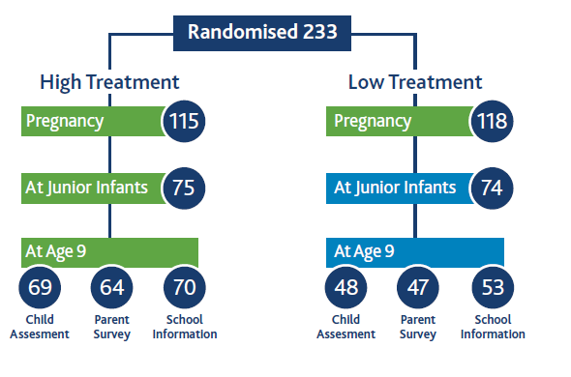
How Many Families Took Part?
65%
63%
59%
42%
45%
40%
At Age 14
At Age 14
52
47
p-value: 0.406

Slide 13
WHAT DID WE FIND?
A few results……

Slide 14
Cognitive Skills
British Ability Scales III
General Conceptual Ability - overall score reflecting general cognitive ability
Spatial Ability Score - assesses problem solving, spatial visualisation, short-term visual memory
Non-Verbal Reasoning Score - assesses inductive reasoning
Verbal Ability Score - assesses verbal reasoning, verbal knowledge, expressive language
 | M_{HIGH} (SD) | M_{LOW} (SD) | Effect size | p value | p value adj.
General Conceptual Ability | 85.41 (14.04) | 76.76 (10.74) | 0.70 | 0.003 | 0.010
Spatial Ability | 94.09 (17.77) | 86.28 (13.02) | 0.51 | 0.012 | 0.012
Non-Verbal Ability | 82.94 (12.36) | 76.57 (11.62) | 0.53 | 0.015 | 0.023
Verbal Ability | 87.39 (12.82) | 80.42 (9.89) | 0.61 | 0.016 | 0.023

Slide 15
Distribution of Cognitive Skills
Percentage of children

Slide 16
Cognitive Skills - % Below Norm
SIGNIFICANT DIFFERENCE

Slide 17
Executive Functioning
NIH Toolbox for Assessment of Neurological and Behavioral Function Cognition Battery
 | M_{HIGH} (SD) | M_{LOW} (SD) | Effect size | p value | p value adj.
Inhibitory Control | 95.10 (17.78) | 98.27 (17.57) | -0.18 | 0.790 | 0.790
Attention Flexibility | 111.49 (20.52) | 113.94 (19.84) | -0.12 | 0.624 | 0.794
Working Memory | 102.44 (16.20) | 94.68 (13.89) | 0.52 | 0.023 | 0.052

Slide 18
Socio-emotional skills – BPM Scores
Brief Problems Monitor
 | M_{HIGH} (SD) | M_{LOW} (SD) | Effect size | p value | p value adj.
BPM Internalising problems | 58.80 (7.60) | 58.56 (7.45) | -0.03 | 0.655 | 0.655
BPM Externalising problems | 55.14 (6.12) | 55.55 (6.56) | 0.06 | 0.392 | 0.625
BPM Attention problems | 60.75 (7.67) | 65.31 (7.26) | 0.61 | 0.007 | 0.015

Slide 19
Socio-emotional - % at risk of attention problems
63%
41%

Slide 20
Socio-emotional skills – Other measures
SMFQ: Short Mood and Feelings Questionnaire
e.g. “I felt so tired I just sat around and did nothing”
Self-esteem: Rosenberg Self-esteem Scale
e.g. “At times I think I am no good at all”
Life Satisfaction: “Here is a picture of a ladder. The top of the ladder “10” is the best possible life for you and the bottom “0” is the worst possible life for you. In general, where on the ladder do you feel you stand at the moment?”
 | M_{HIGH} (SD) | M_{LOW} (SD) | Effect size | p value | p value adj.
SMFQ | 6.95 (6.65) | 7.84 (6.56) | 0.13 | 0.413 | 0.508
Rosenberg Self-esteem Scale | 18.76 (5.47) | 17.60 (5.86) | 0.21 | 0.277 | 0.455
Life satisfaction (1-10) | 7.48 (2.16) | 7.30 (2.06) | 0.08 | 0.435 | 0.435

Slide 21
Health
Self-assessed health: “Would you say your health in general is...Excellent, Very good, Good, Fair, Poor”
Diet: “How often do you eat breakfast/fruit/veg/fast food in a week”
Pubertal Development Scale
Growth spurts, skin changes, voice changes, body hair, breast growth, menstruation
Waist-to-Height ratio: Measured by fieldworker. Waist size (cm)/height (cm).
Substance use: Binary measures indicating whether ever smoked cigarettes, vaped, drank alcohol, smoked cannabis or took illegal drugs
No impact on health outcomes, except Waist-to-Height ratio - almost a 6 cm difference in the waist circumference of both groups.

Slide 22
Health Behaviours
 | M_{HIGH} (SD) | M_{LOW} (SD) | Effect size | p value | p value adj.
Ever drank alcohol | 23% | 25% | 0.04 | 0.547 | 0.671
Ever smoked cigarettes | 5% | 6% | 0.06 | 0.398 | 0.713
Ever vaped | 33% | 23% | -0.21 | 0.845 | 0.845
Ever tried cannabis | 5% | 10% | 0.22 | 0.140 | 0.432
Ever took illegal drugs | 0% | 2% | 0.25 | 0.106 | 0.514
Age at first drink | 13 | 13 | 0.14 | 0.460 | ~

Slide 23
Educational Engagement
School liking: “How do you feel about school in general?”
School engagement: 4-item Classroom Climate Measure e.g. “I look forward to going to school”
School belonging: 9-item School Belonging Scale (SOEP). e.g. “I feel like an outsider in school”
School absences: “In the last 12 months, how often did you miss school without your parents’ permission?
Aspirations: “How likely do you think it is that you will go to third level education e.g. university/college? Slider running from 0-100.
No impact on educational engagement measures….except…..

Slide 24
Educational Engagement – Intention to go to university %
66%
51%
51%

Slide 25
Parent-Child Relationship
Inventory of Parents and Peer Attachment-Revised
Trust e.g. “My mother/father respects my feelings”
Communication e.g. “My mother/father can tell when I’m upset about something”
Alienation e.g. “I don’t get much attention from my mother/father”
 | M_{HIGH} (SD) | M_{LOW} (SD) | Effect size | p value | p value adj.
Mothers
Communication | 35.93 (7.64) | 33.12 (7.91) | 0.36 | 0.058 | 0.244
Trust | 37.94 (5.58) | 38.40 (7.15) | -0.07 | 0.690 | 0.690
Alienation | 12.59 (5.05) | 13.77 (4.86) | 0.24 | 0.211 | 0.410
Fathers
Communication | 31.17 (9.11) | 28.49 (10.78) | 0.27 | 0.142 | 0.392
Trust | 37.10 (7.64) | 32.85 (11.09) | 0.45 | 0.029 | 0.150
Alienation | 12.51 (5.53) | 13.76 (6.26) | 0.21 | 0.313 | 0.429

Slide 26
Parent-Child Relationship
75%
63%
63%
42%

Slide 27
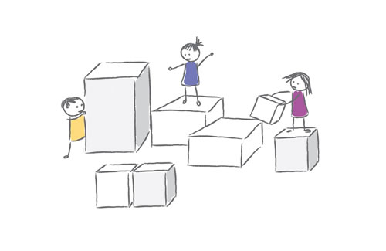
Summary
PFL continues to have a sizeable impact on children’s cognitive skills approximately 10 years after finishing the programme (0.77 SD)
Effect size similar to Age 4 & Age 9, thus no evidence of fade-out
No effects on time & risk preferences; socio-emotional skills; school engagement
(Some) effects on working memory; attention; health (waist-height ratio); expectations (go to college); and parent-child relationship
Effects larger than other home visiting programmes

Slide 28
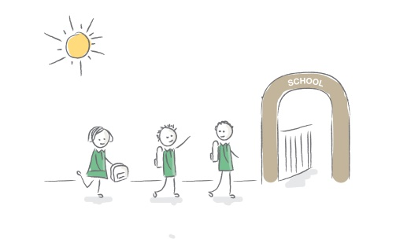
Why are PFL Effects Different?
PFL starts earlier and is longer in duration than most home visiting programmes
Quality of the home visitor-parent relationship had time to build and develop
Programme may have had a permanent impact on areas of the brain that are particularly malleable to intervention during early childhood
Multi-treatment approach may help engage families who favour one particular form of treatment over another
Universal nature of the eligible criteria

Slide 29
Current Status of PFL
PFL operating in 10 sites around Ireland – training hub for other sites
In 2023, PFL added to the US’s Department of Health and Human Services HomVEE list making it eligible for HVP funds
Currently conducting a second PFL trial in Chicago with the Center for the Economics of Human Development at University of Chicago

Slide 30






Thank you
Questions:
Orla.doyle@ucd.ie
Additional information see:
www.preparingforlife.com
http://geary.ucd.ie/preparingforlife/
https://cehd.uchicago.edu/creciendojuntos

