Slide 1

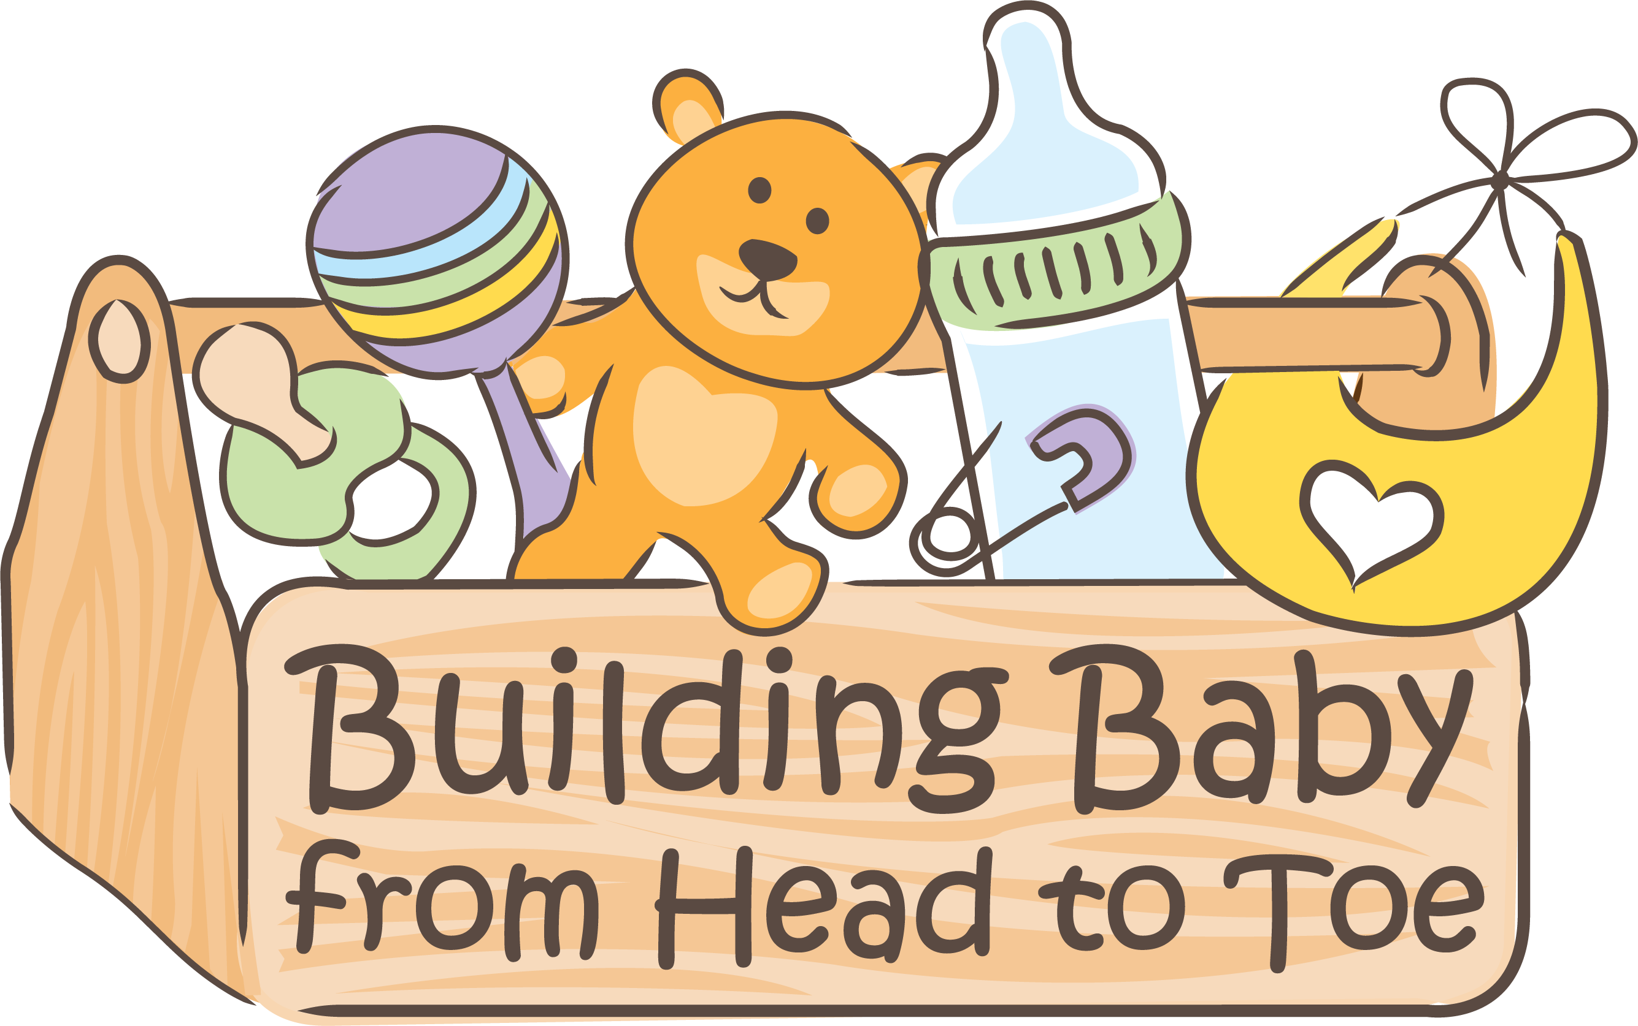
An Introduction to Infant Mental Health
Notes:
Hello and welcome to you all and thank you for joining us today.
I am….. And this is…. And we are delighted to see you all here, we hope that the next 2 hours is enlightening, educational, interesting and enjoyable.
Relaxed approach re feeding, nappies, crying.
Fire exits
Toilets
Questions
Booklets & notes section
CP & GDPR
Break?
Round of introductions

Slide 2
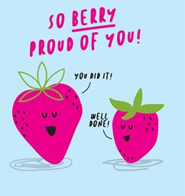
You made
it here !
Notes:
As parents or parents to be, you can so often spend much of your time and energy looking after and taking care of your little ones/bumps, that you can have little time or energy leftover to care for yourselves.
But the better YOU you are, the better YOU you will be as a parent!
And if that is all you take from today, your toolbox will be doing pretty well!
So, before we go any further, we would like to take a moment, get comfortable in he chair you are sitting on, allow your feet to ground you on like an anchor to the floor. Take a breath and congratulate yourselves for making it here.

Slide 3

Greatest Wish
Notes:
You came here for a reason today, to learn more about doing the best for your child.
So, you should all have your Building Babies from head to toe workbooks, we’d like you to take a minute to think about what your greatest wish might be for your babies….it might be that they have good health, lots of positive friends, a life they enjoy. Whatever it is, we want you to keep this in your mind as we work are way through this morning/afternoon.
Because all we talk about, will be related to the greatest wishes we have for our children, how do we get them there, how do we build them up, from head to toe!
So when you're ready, we’ll give you a minutes to write this wish down in your workbook. Not to show anyone, or read it out, or for anyone else to see.
*5 MINS TO WRITE*
With the greatest for your child in mind and hoping we all feel a little bit more grounded and present, we would now like to know what do you all hope to come away with today? What did you think of when you heard about today, or what did you expect (ask the question to the room). FLIP CHART
What do we hope you all will come away from today with???

Slide 4

To Do List
The Nerdy Bit
The Toolbox
A Plan/Hope
Notes:
Ok thank you all for sharing that…. so what’s on our to do list for today and what are we going to be talking about?
The toolbox bit….well we’re really sorry to inform you at this point….we will NOT be giving you any new tools to use with your babies today. We ARE however, going have a good dig around and see what tools already in it – because the likelihood is, there are loads of tools there, really good exclusive, and very skilled tools, that you may not have even realised are there, but are being used every day to build your babies, from head to toe.
And we will also take a peek at a little Plan or Hope for yourselves. We are going to have a look and see if we need to move around one or two placing of things on your priority list. So often we can run ourselves down, leave our own wellbeing to the end of the list. STOP! A famous child psychoanalyst said “there is no such thing as a child, a baby alone doesn’t exist”. In other words, for your child to be ok, you as parents need to mind yourselves.
But before we do all that, and first on the list, we want to go through the Nerdy Bit. Now don’t fall asleep on us, there are actually some really interesting nuggets of science that will help to frame the next couple of hours and to put what we’ll talk about into perspective.
And we’ll throw a few Myth busters in there for good measure.

Slide 5
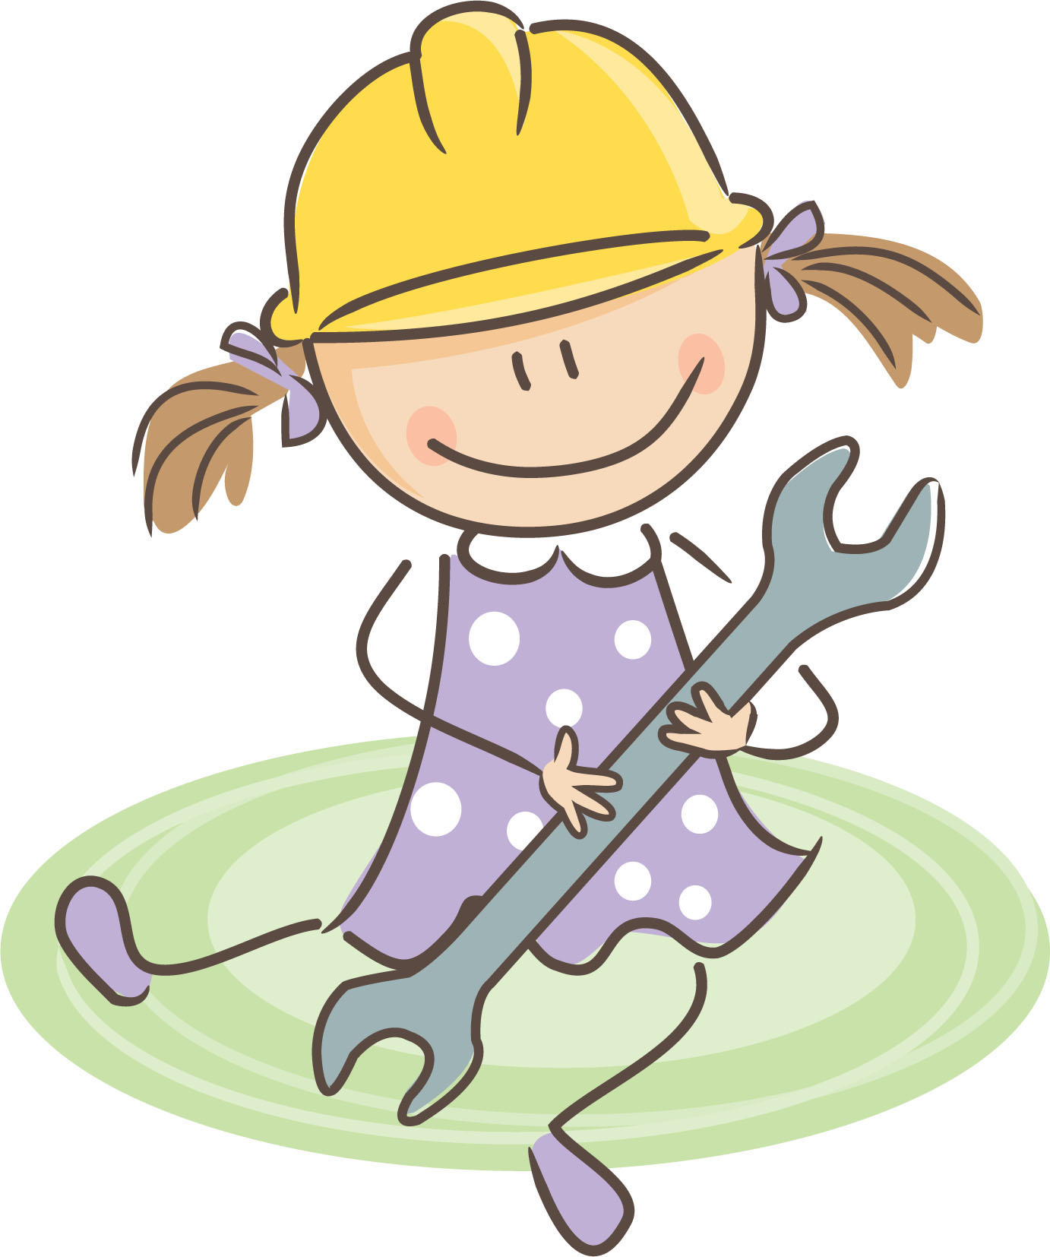
True
Or
False?
Children don’t have ‘mental health’ before they’re about 2 years old
Notes:
So lets start with a Myth Buster!!!!
False…. This is a common misconception!
Infant Mental Health is: “how well a child grows socially and emotionally from birth to three years”.
These early or formative years lay the foundation for; being able to express emotion which can be called emotional intelligence, feelings of security, feelings of importance and self esteem – therefore, reinforcing these kinds of building blocks in their little brains, can mean that your babies can grow to have self confidence, secure relationships in later life and feel like they are important and loved.
Its never too late to work on these building blocks, but the earlier we can lay them, the quicker they build.
Which leads up nicely on to the brain...

Slide 6
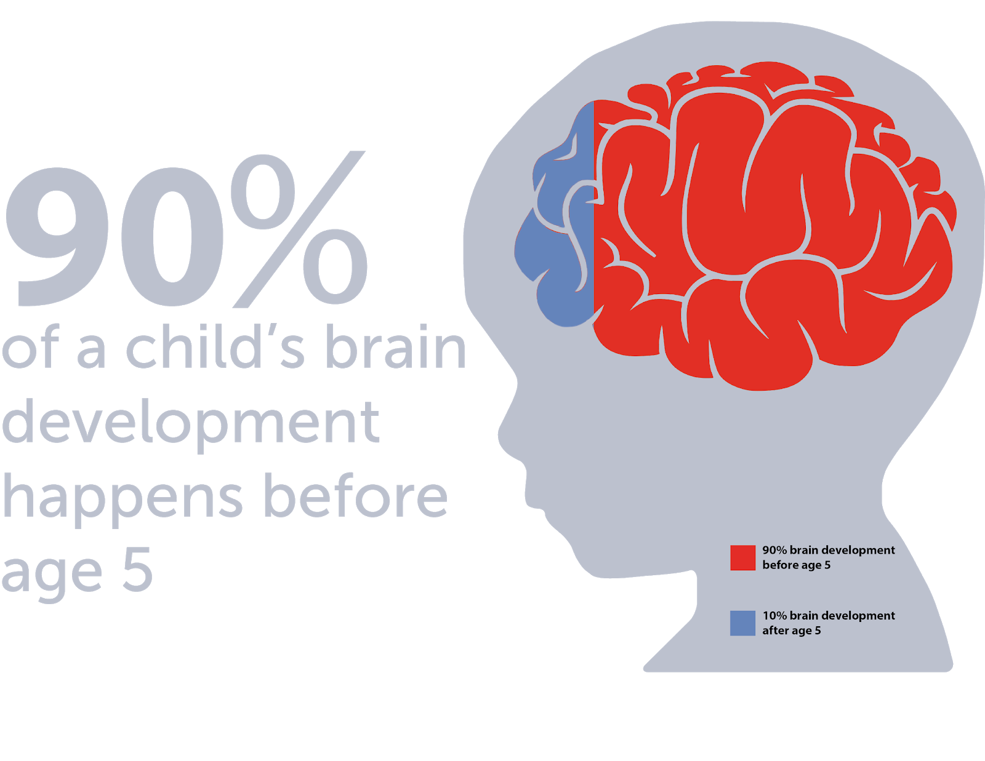
First, The Nerdy Bit
Did you know?
90%
of a child’s brain development happens before age 5
Notes:
Ok, so lets start with the nerdy bit – we’ll get it out of the way but it will also help you to understand the rest….
Did you know that 90% of a child's brain development happens before the age of 5? How incredible is that? The pace that a child brain is growing and developing, connecting and learning during the first few years of life is amazing!
That means, that early childhood is a critical and sensitive period for brain development. It also means that when you become a parent, you also become a brain architect! No pressure. Every positive interaction and experience that your child has, is going to contribute to building that strong brain architecture! Consider it a stage in your child’s life that is filled with limitless potential! This does not mean that we should start introducing a second language to our babies now and force ourselves to attend clap handies 5 days a week, with a spot of baby sensory at the weekend – no. All baby needs during infancy is simplicity! They need you and they need the people around them. Everything else is bells and whistles. We’ll be unpacking why shortly.

Slide 7

Neural Connections and Networks
It is estimated that the brain is making around 1 million new neural connections per second in the first few years of life
Notes:
And this fact here ‘it is estimated that…..’ is just so incredible! 1 million new neural connections per second! The fancy term for this is: transient exuberance.
Babies are born with most of the brain cells that they will ever need. Our job, over the first few years is to connect those cells up based on experience. When it comes to the mental health of the infant, this is primarily done through the relationship that we have with our child. Warm, positive, compassionate care during early childhood is the foundation of so much in later life. HOWEVER, that doesn’t all have to come from YOU! Take off your superhero cape mamas because there is no such thing as a perfect parent in this room. That care, that compassion – it can come from anywhere. You, your partner, your parents, your sibling, your childminder. It’s not all on you!
So, you have this beautiful little baby whos brain is developing at a rate of 1 million neurons, every single second right now. As they grow and develop, they actually lose loads of those connections (the fancy term for that one is ‘synaptic pruning’). So, that kinda means that, if something simple happens a couple of times during EC, baby is kinda most likely to forget. So if you do start speaking French for a week at home, don’t expect them to remember. It’s the repetitive stuff that really counts.

Slide 8
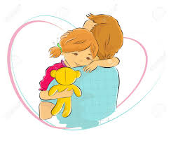
Neural Connections and Networks
Those connections are built through loving and caring interactions with parents and caregivers and by children exploring the world through their senses.
Notes:
There is no magical potion for building really strong brain architecture in the early years. There is no secret recipe. Babies' brains are built through mundane everyday moments. Because those everyday moments add up to be the big picture. Building a strong brain is NOT about grand gestures. It is not about perfection. It is an accumulation of hundreds and thousands of tiny-moments.
ASK: Can you think of one person who made you feel safe and valued when you were growing up? Think for a moment – what did they do? How did they do it? What did it feel like being in that person's presence?

Slide 9

It's never too late!
Research shows that our brains aren’t fully developed until we are around 25 years of age! And even then, they never stop changing and adapting!
Even though the first few years of life are the busiest for your baby's brain – it is important to remember that change is always possible!
Notes:
Consider how many years it has been since you were 25? Probably not that many! Your own brain has only been ‘fully’ developed for that long! And please remember that change is always possible. It may be more difficult for us to learn a new language nowadays than it was when we were children, and it may be more challenging to change the way we think about ourselves, or the world, but it is ALWAYS possible. It is never, ever too late. Right now, with our babies, it is simply easier to instill the foundations of a positive self-image, self-esteem, relationships and overall positive mental wellbeing because their brains are bursting with 1 million new neuronal connections every single second.

Slide 10
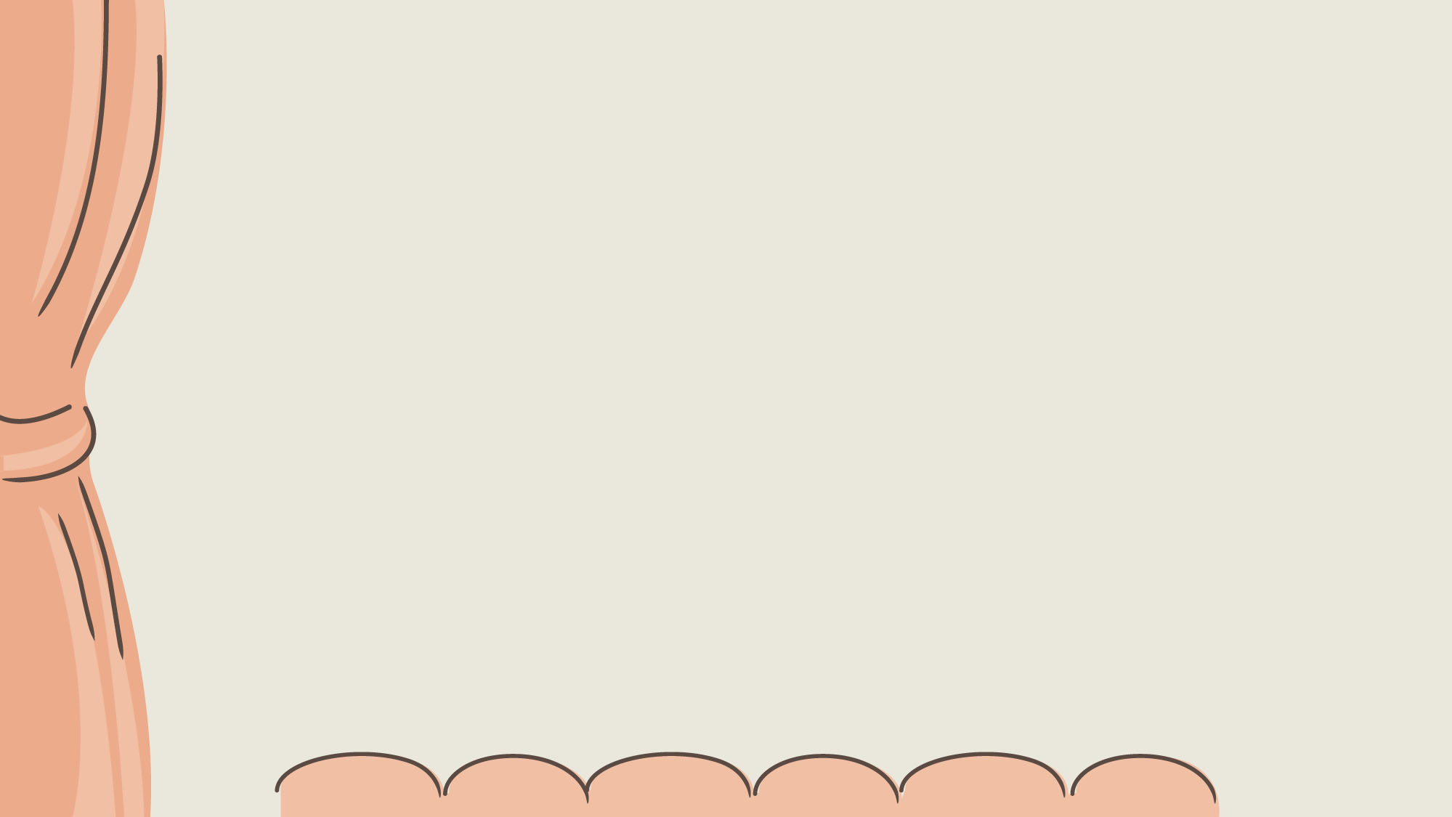


Everyday Moments Matter Most
Notes:
This is an example of an everyday moment that we could so often take for granted. It is an everyday ‘loving and caring interaction’ (as cited on the previous slide).
Q) What is this child learning in this moment? Or how might it feel to be this child, in this moment?
*Ask the group*
I have a voice and I have lots of things to say
I deserve to be listened to and to be heard
I am an interesting conversation partner
I am worthy of the time and attention of other people
I am important
These are all things that are beginning to lay the foundation of self esteem, security and being loved.

Slide 11
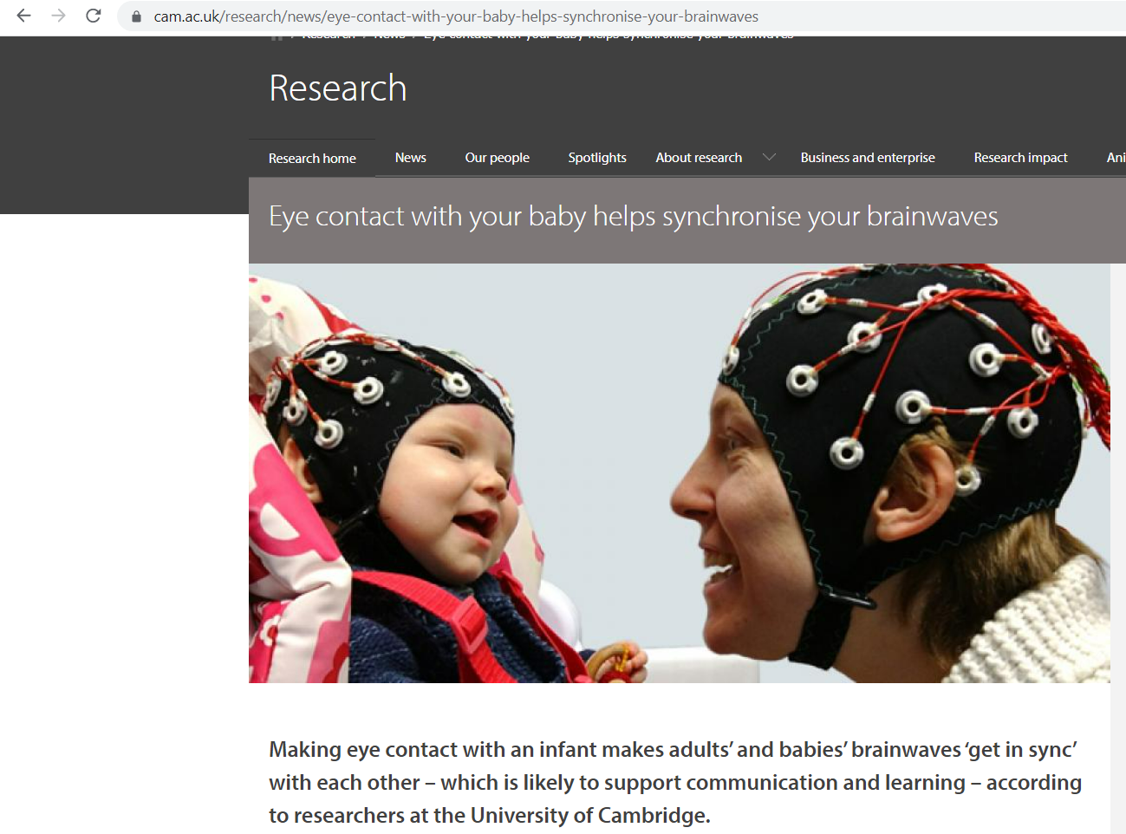
Eye contact with your baby helps synchronise your brainwaves
Notes:
Communication is more successful if their brainwaves are in synchrony.
A study done by the University of Cambridge observed babies brain waves while watching videos of adult singing a nursery rhyme. Brain waves were more in sync when mutual gaze was shared.
Researchers then observed the babies while in the room with adult room singing; in real life shared gaze…..BW were in sync even more.
Interestingly, the greatest synchronising effect occurred when the adults' head was turned away but her eyes still looked directly at the infant. The researchers say this may be because such a gaze appears highly deliberate, and so provides a stronger signal to the infant that the adult intends to communicate with her.

Slide 12

Notes:
This may all sound a little overwhelming.....omg I need to build my babies brain and make them secure and do it all now.........Before we go any further….we’ve got some really big news!!! Its pretty huge news actually, and we’re hoping you’re going to take it very seriously.
Get your pens and pencils at the ready and note this down….
YOU
ARE
ENOUGH! (just the way you are, you as your imperfectly perfect self)
This may be news to you, so much of what you are already doing is having huge impacts on your little ones. When relationships are ‘good enough’, that is when children go on to develop healthily socially and emotionally. Relationships are at the heart of building strong brain foundations for mental health.
In fact, some things you do every day, is actually changing the structure and physical formation of your babies' brains. And we will look at these things you may already be doing through this workshop.

Slide 13
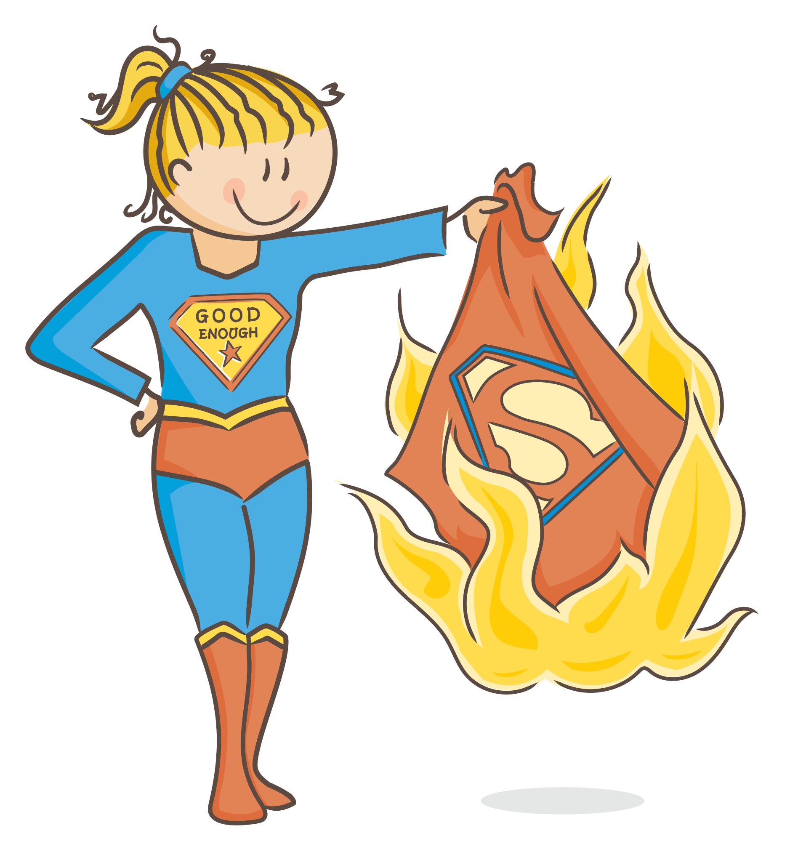

@thismamadoodles
Notes:
To be enough for your baby, the research shows that we do not need to be perfect!
PAUSE!

Slide 14


True
Or
False?
When your baby is first born, you are sure to experience a sudden and immediate bond with them
Notes:
The more families I work with or mothers I speak to, the more I hear that, this dramatic moment with warm fuzzy feelings and a deep intimate bond, and glitter falling from the sky......DOESNT ALWAYS happen!!!!
Your body has just cooked a human for 9-10 months and has just given birth to it. Its exhausted and probably sore and youre dealing with hormones and emotions.
For some people, this lovely bonding moment does happen, but more often then not, its takes time to get to know your baby, time to feel connected. AND THAT IS OK!

Slide 15
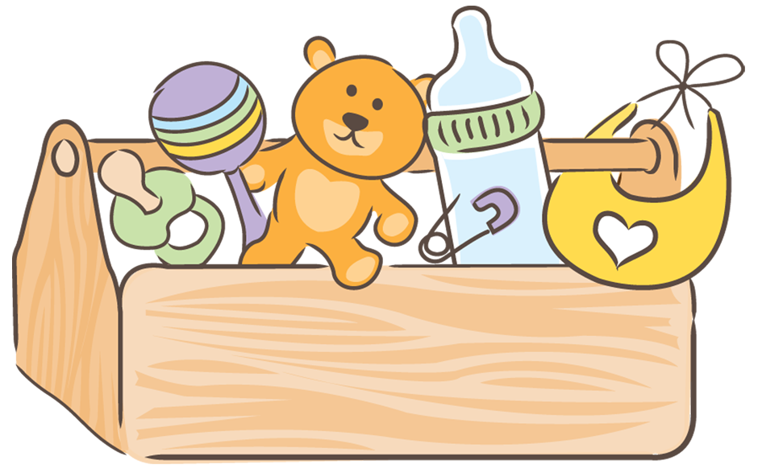
The Toolbox
Skin to skin & Touch
Attunement
Rupture & Repair
Play
Serve & Return
‘Being with’
Notes:
So the big news that YOU are enough, is why we will not be giving you any new tools. We want you to have a dig around your toolbox and see the things you may already do that is helping support and nourish your baby/child and your relationship with them.
We’re going to talk about ;
Skin to Skin and the importance of touch - its first thing that forms in utero and first of the senses etc.
Attunement and how we can read our babies signals and cues
Rupture and repair, and how day to day there can be a rupture in your relationships, but how repairing these ruptures can actually strenghthen your connection
Were going to unpack the secret powers of play
Were going to look at serve and return and the metaphorical game of tennis we play with our children.
And lastly we will discuss the concept of 'being with' and when sometimes the best thing to do is not to do.

Slide 16
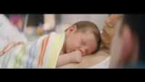
Skin to Skin & Touch
Notes:
Thise piece of viewing is just an example, of how something simple like putting your baby on your skin, can do so much! The magic power of touch!
Q) What might it feel like to be that baby – so fresh and new to the world – and to be placed on the chest of the person whose heartbeat is so very familiar to you?
*Ask the group*
The world is so big and so vast. It feels so different to everything that I am used to. But this heartbeat is familiar. This voice is so familiar.
“I am safe, and I am loved”.
And again, we go back to things we can do in everyday life, that have a huge impact on building our babies from head to toe.
I am safe, I am loved, I am important.

Slide 17
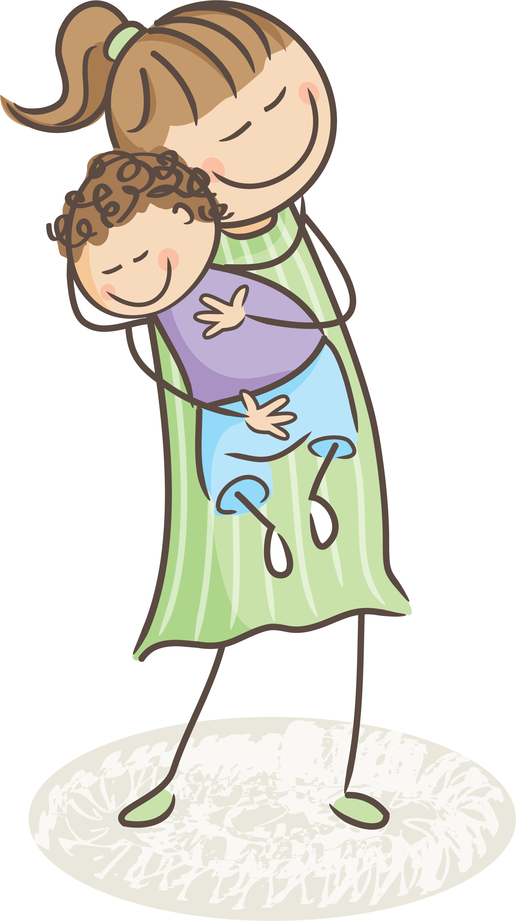
Skin to Skin & Touch
Enhances attachment
Boosts cognitive development
Reduces stress and anxiety
Close physical contact releases oxytocin
Touch = containment
Notes:
- So as we spoke about earlier, attachment and bonding isn't always automatic/innate or easy. Sharing touch be it skin to skin or massage or stroking your babies hand while feeding, it all supports the growth of attachment.
- Studies have shown that infants who experience more physical contact with caregivers demonstrate increased mental/cognitive development in the first six months of life compared to young children who receive limited physical interaction
- Research has also proven that infants who receive more affection and touch, are less stressed and anxious when they are adults.
- Oxytocin is a hormone that is being research for treatments for depression and anxiety as it provides a calming effect.
- Containment provides a sense of containment which can also support babies to feel safe and secure.

Slide 18

Attunement
Attunement is the ‘emotional sensing’ of another person. It is a fancy way of saying that we can be ‘tuned into’ our child’s needs, wants and desires, and they are ‘tuned into’ us.
Consider attunement to be like a dance.
Notes:
ASK: Ask group to identify the % of the time they believe that they need to be ‘tuned in’ to babies needs? The % of the time they believe that they need to ‘get it right’.
The research shows that 30% is what constitutes for ‘good enough’ (when the group have had a chance to respond, comment on the reassuring nature of 30% being ‘good enough’ – comment on the fact that there’s possibly a collective sense of relief in the room). Being attuned to our baby helps them to form templates in their mind that the world is a good place to be, filled with people who love and care for them. They learn that they are worthy of love, and that people are trustworthy.
Attunement is the parental ability to be responsive to child signals, understand them, and respond appropriately, while adjusting to the child's needs. You know your baby best. Likely more than anyone else in the world. Think about it like being ‘tuned into your babies channel’. However, attunement is also a little like a dance – there are inevitably going to be missteps and fumbles.
Dance analogy: at first, when you're learning to dance with a new partner, there are missteps and fumbles. It is awkward and messy. You stand on their toes and vice versa. But eventually, you come to learn one another's rhythm. You slowly begin to synchronize movements. There are always going to be moments when you fall out of time with each other, or the music, or step on one another's toes, but you come to know your partner so well, and you know the music so well, that it becomes easier and easier for you to get back into synchrony, and so, the dance continues.. with the audience having barely even noticed the misstep. This is attunement.
DO: Do a dance for the group! (comment on the fumbling at the beginning, the gradual finding of pace and rhythm, how you eventually get quicker and how sometimes, something else distracts you from one another and you fall out of time, or miss a step.. It is not the mistep that counts.. It is the rebalancing that matters.. Getting back into time is what is important. Ruptures happen. It’s inevitable. It’s the repairs that count – 30% synchrony is good enough).
Attunement might look like an adult hearing a baby cry, and knowing from the way that they are arching their back, that they need to be burped. In adult relationships, attunement might be an adult who notices a difference in their friends usual body language, and asks them if they are ok.

Slide 19
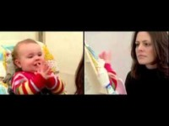

Attunement
Notes:
The following video can be a little distressing to watch, so mind yourself in that. We want to take this moment to demonstrate just how tuned into us our babies can be – they already understand so many social and emotional cues. When it comes to infant mental health, think about relationships are being one of the most fundamental building blocks. The mundane, everyday moments, between caregiver and child, that are repeated over and over again, are the foundations of IMH. Take a look at this mother and baby scene…
PLAY VIDEO
Ask group for thoughts and feedback. Was there anything there that surprised you?
Being sensitive to your baby’s signals and responding to their needs enables your baby’s brain connections to form. This gives them a lifelong capacity for resilience against stress. In turn, this leads children to make sense of their emotions, learn to understand the world around them and feel secure in the relationships they have.
BUT!!!!! Sitting and sharing gaze with your baby for long periods of time, is not always practical or necessary. And things will need to be done around the home, getting bottles/meals ready for example. If your baby becomes upset you are not available in that moment, take some time when you are available to make the repair, "Sorry I wasn’t paying you attention, but I'm here now". Ruptures happen, but it’s the repairs that count.

Slide 20
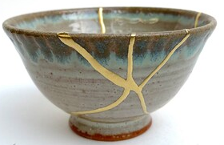
Rupture and Repair
All relationships have ups and downs. It is impossible to get things right all the time.
Luckily, we don’t have to! (30%)
It’s the thing that you do, after the thing you did that’s most important!
Notes:
ASK: Have you ever had an argument with somebody? You argue your point, you get upset, they get upset and then after a while, you work through it – you say the things that need to be said and you find resolution? How does it feel when resolution has been found? (comment on how relationships can very often feel stronger after having been repaired from a rupture).
Kintsugi is the Japanese art of repairing broken pottery with solid gold – it is built on the idea that in embracing flaws and imperfections, you can create an even stronger, more beautiful piece of art. Sometimes, in the process of repairing things that have broken, we actually create something more unique, beautiful and resilient.
It’s the thing that you do, after the thing that you did that’s most important – ruptures are an inevitable part of relationships - it’s the repairs that matter. It’s the repairs that help to strengthen the relationship. Ruptures, followed by repairs, help children to learn that they are resilient and that when things go wrong, they can be set right again.

Slide 21
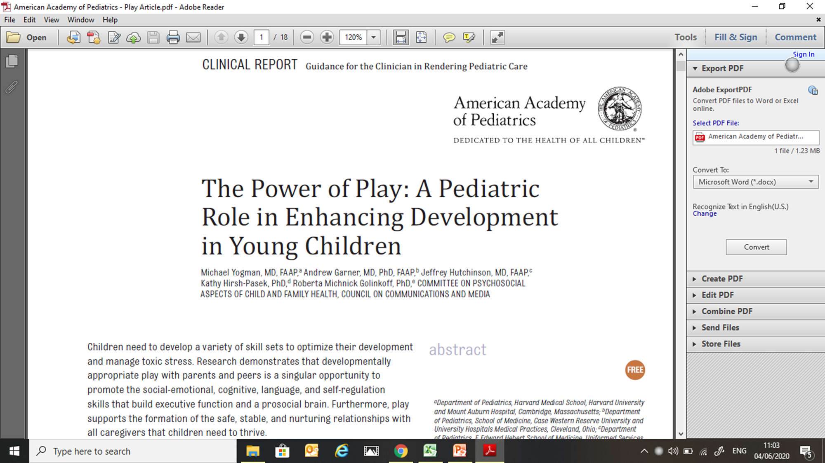
Notes:
Play is not some sort of frivolous activity that children engage in because they enjoy it. Play is vital for all aspects of development. It is so important that it is enshrined within the united nations convention on the rights of the child as a fundamental human right. It forms the basis of our entire early years curriculum (aistear) and there have been countless research articles, spanning decades written about it. One of my favorites is a 2018 article from the American Academy of Pediatrics that speaks about the value of play for all children (to promote resilience and wellbeing), but also goes on to recommend that pediatricians promote and effectively PRESCRIBE play at doctor visits in the US. Wow.

Slide 22
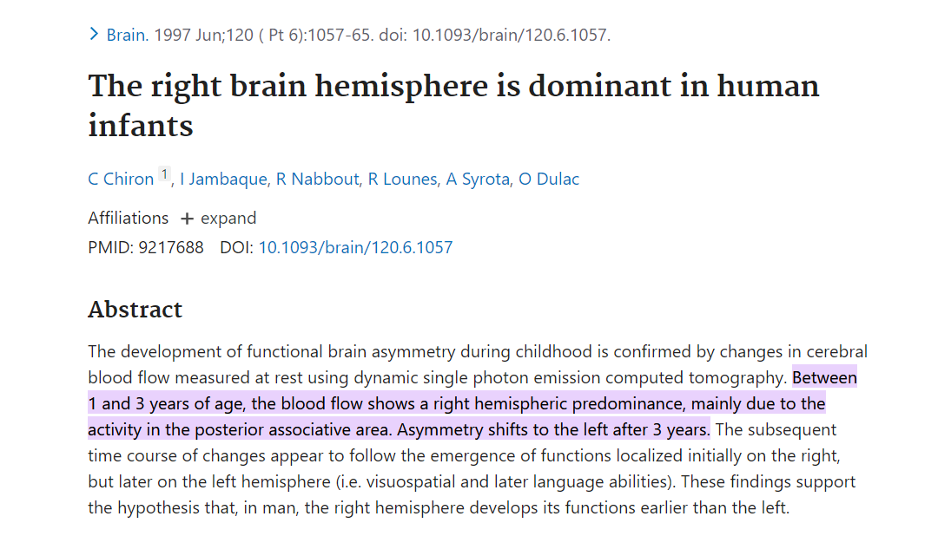
Notes:
Quite literally, if you were to put a baby under a brain scanner – you would notice a disproportionate level of blood flow in the right hand side of their brain during the first three years of life. What is the right hand side of the brain typically associated with? (flick to the next slide for answer to this question)

Slide 23
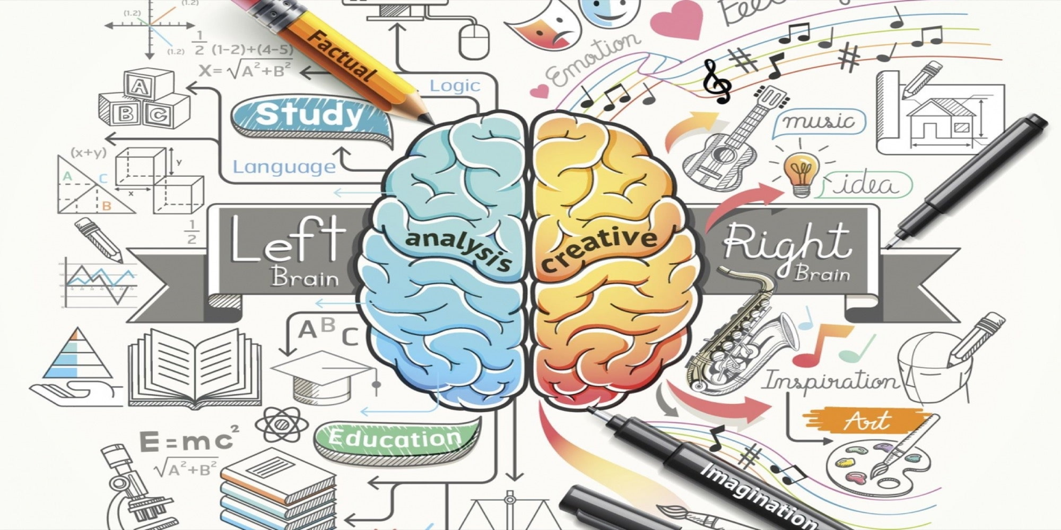
Notes:
It is typically associated with art, music, drama and PLAY. The left hand side of the brain is typically associated with logic and language (this is an opener for ‘play is the language of the child’).

Slide 24
PLAY
Play is the language of children!
We can have extremely rich conversations with our children through the medium of play. Let’s take a moment to consider this...
Notes:
Play is the language of children. You and I – our first language is words. But developmentally, that is not the same for children. Children can communicate so much more to us via an hour of play then via a week of talking and the same is true when reversed. When we sit down on the floor and simply play with our child (even for just ten minutes a day), we are communicating so, so much more than we could by talking for days.
You see, there are secret powers to play. Let’s unpack some of them now..

Slide 25
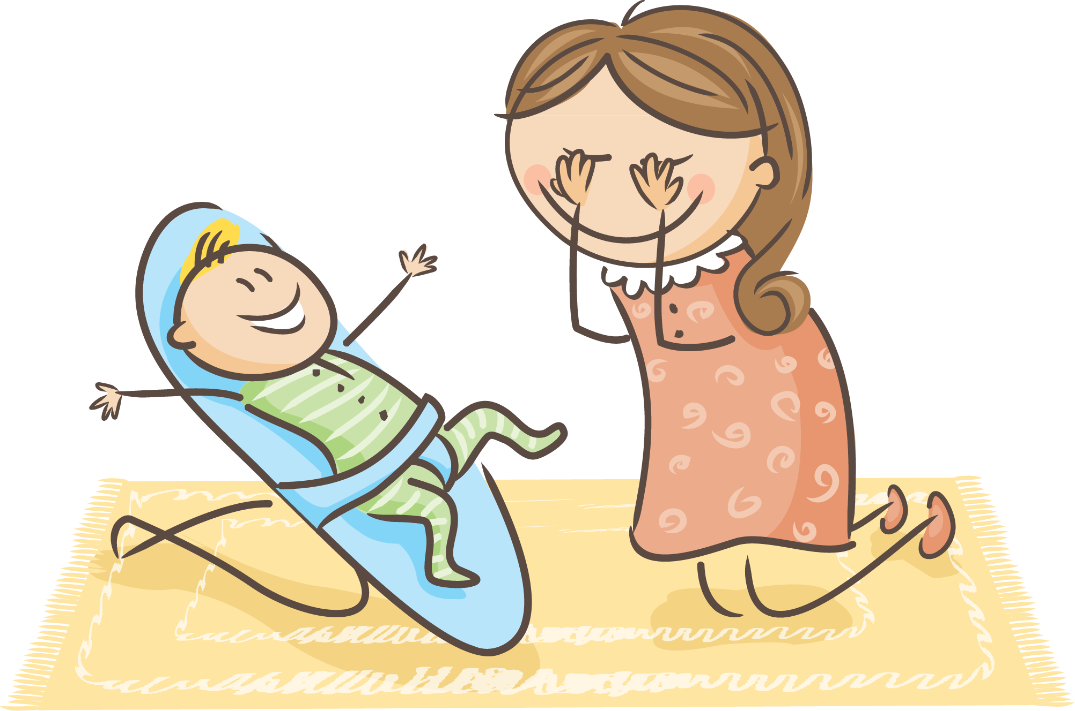
The secret power of peek-a-boo
Motor Skills
Speech and Language Development
Social and Emotional (turn taking, confidence, anticipation, surprise & excitement and shared joy)
Cognitive Development: Object Permanence & Problem Solving
Notes:
Motor Skills: reaching, balance, agility, coordination
Speech and Language Development: Saying ‘peekaboo’, ‘where’s mummy’, ‘here I am’. Foundations to the beginnings of a conversation.
Social & Emotional: turn taking, playing with others, increasing their confidence and playing with others. This game also helps babies experience emotions such as surprise and anticipation in a contained, positive way. The child also experiences excitement and happiness when you suddenly appear from under your fingers!
Cognitive Development: Object permanence is the ability to understand that an object or person is still there even though it/they can’t be seen. It is a skill that develops around 8/9 months (right at the time when separation anxiety usually begins – no surprise why when you consider object permanence). This skill also links to improving problem solving skills.

Slide 26

What unconscious message might a child receive from the following games?
Row, row, row your boat
Jump into my arms!
“All around the garden”
Notes:
Divide group up into three small groups, if possible, but if not, select one of the games and discuss in the large group. Discuss the potential socio-emotional impact of the game(s).

Slide 27
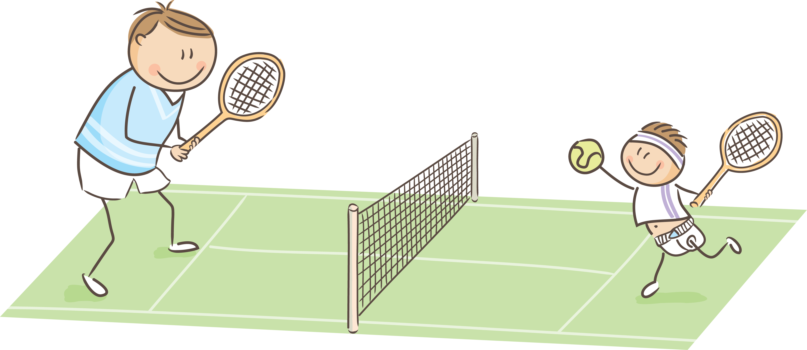
Serve & Return
Just like in tennis…
one person serves
& the other returns…
Notes:
When a baby or child gestures or cries and an adults responds in a way that’s says, I hear you, this support brain architecture and helps their brains to grow and strengthen.
This is a simple serve and return!
Just like a game of tennis, your baby serves with a smile, glance or sound and you return by smiling back or reaching out a finger.
Baby returns by grasping your finger..... and the game has begun!

Slide 28
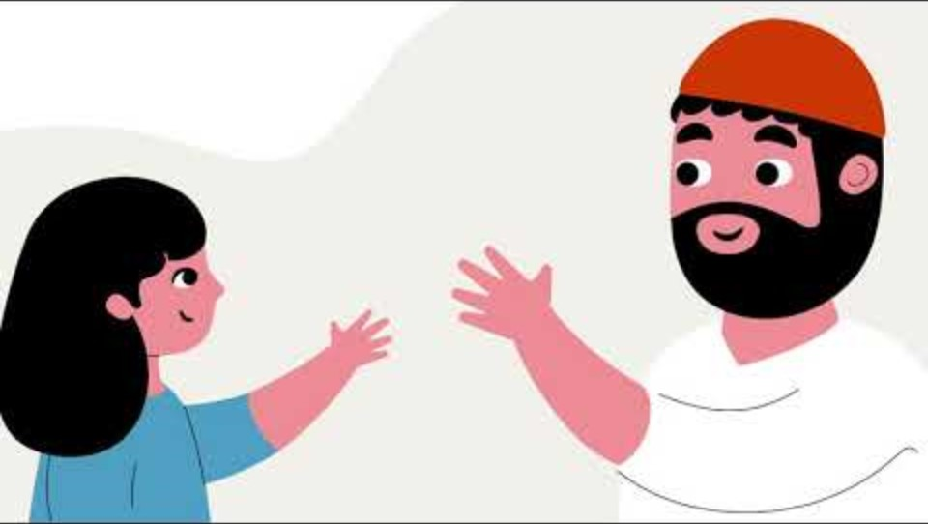
Serve & Return
Notes:
Can anyone think of a time you may have had a ‘serve and return’ interaction with your baby?
Serve and return interactions can include when you notice what your baby is paying attention to and comment on it…when they acknowledge what they are showing you or when you acknowledge when they indicate to you that they want something or have had enough of something….
All of these tiny serve and return moments probably happen naturally between you and your baby without you even thinking about it… the more we are aware of them, the more we can takle advantage of them and increase the amount of times they happen…each tiny serve and return moment that happens between you and your child, helps to build the foundation for your child’s lifelong learning and wellbeing
Let's see a couple of serve and return interactions between our very own Caroline and her new baby...

Slide 29
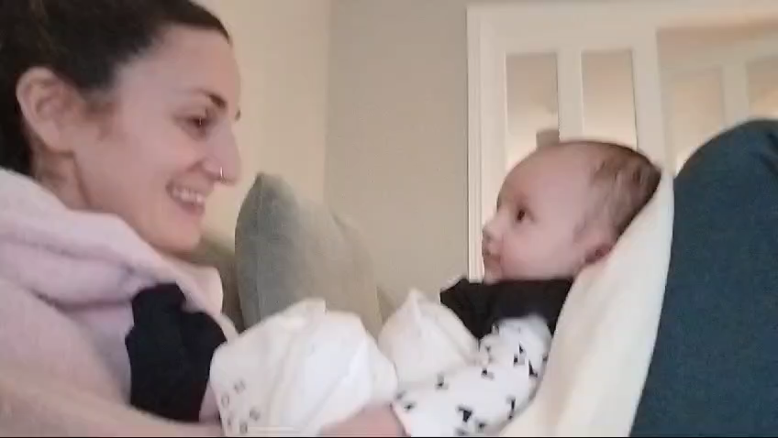

Slide 30
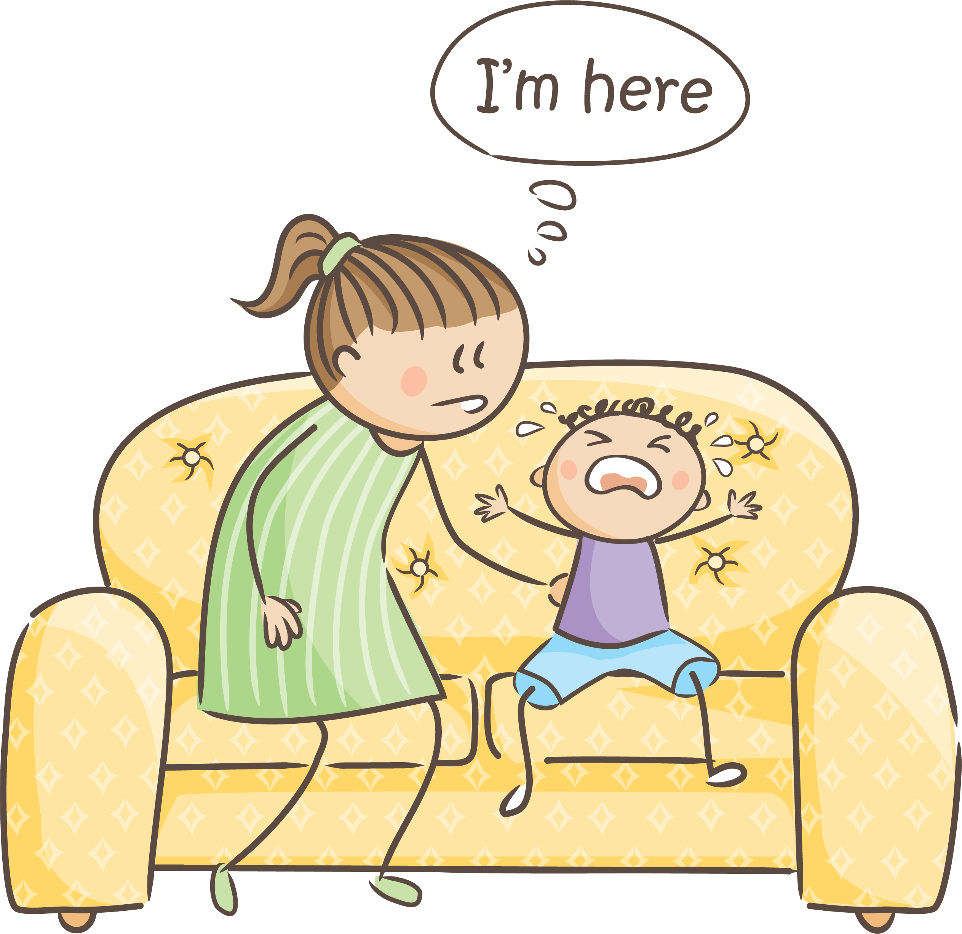
“Being With”: A shift in mind-frame!
Don’t deal with….
instead, FEEL with!
Notes:
It’s not always sunshine and roses. Sometimes, it is hard. Sometimes we do not know what to do – particularly when big feelings are involved. Children do not come into this world knowing how to manage their stress, or their big feelings. But we, as their big, strong, kind and wise caregivers, we can help them to learn. Being able to calm oneself in times of stress is an important life-skill and it’s one that children learn through thousands upon thousands of reptations of being ‘regulated’ (or calmed) by another person – often us.
If a child does not know how to tie their shoe laces, we do not ask them to ‘speak to us when they’ve figured it out’ - we teach them. Our response is not always the same when it comes to managing big feelings. It is not strange for us to tell our child to ‘calm down’ or ‘come back to me when your less angry’. With young children, they don’t know what to do with their big feelings. They need us to use our calm, to sooth their storm. This is the art of co-regulation. This is the art of being-with. Complete the phrase: ‘don’t just stand there….’ (participants will say ‘do something’). In this case, it’s more like ‘don’t just do something, stand there.. Be with). Quote by Jerree Pawl.
If this is something that you want to explore further, please consider joining in on a Circle of Security Programme.

Slide 31
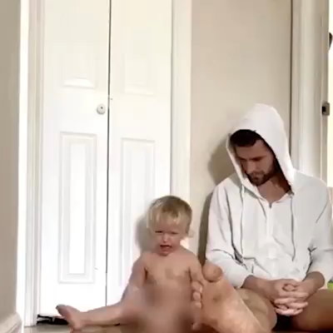
Notes:
Ask the group: What might it feel like to be this child, in this moment? What messages is this dad communicating to his child?
You can handle me and all of my big messy feelings.
They don’t scare you, you don’t run away from them.
I can bring them to you and you will help me.
You will always be there, to be with me.
I am worthy of good things.

Slide 32

True
or
False?
I will spoil my baby if I constantly cuddle them and hold them when they are crying

Slide 33

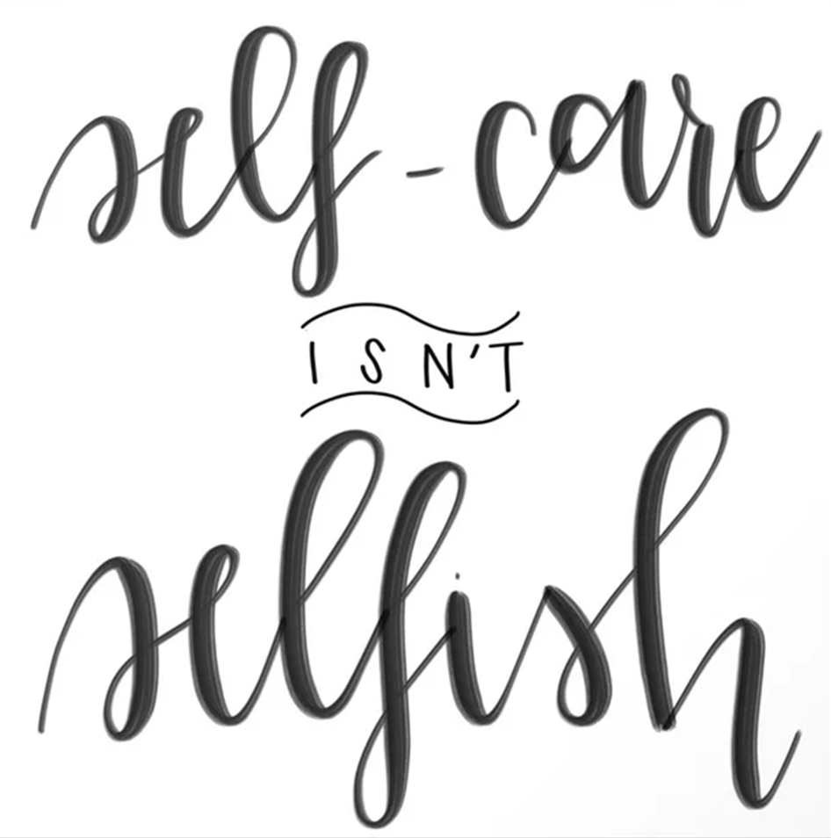
Why self-care?
In order to do any of the things that we have discussed today for our babies and young children, we need to make sure that we are ok first.
Self-care isn’t a parenting luxury!
It is a need and making it a priority, is a skill.
What helps you to feel refreshed and restored?
Notes:
Some people can feel ??? for doing something that they have wanted to do if it included leaving their child, I'm sure some of you here could resonate with that.
If so, how did that guilt benefit you?
Babies should come with a little warning label to say ‘several years of parental guilt included’. Nobody ever warns you about how heavy that feeling is, nor how frequently it comes. This guilt does not serve anyone! Not you, and not your child. If we don’t recognize and prioritize our own needs, we will not be ABLE to operate at our best parenting self.

Slide 34
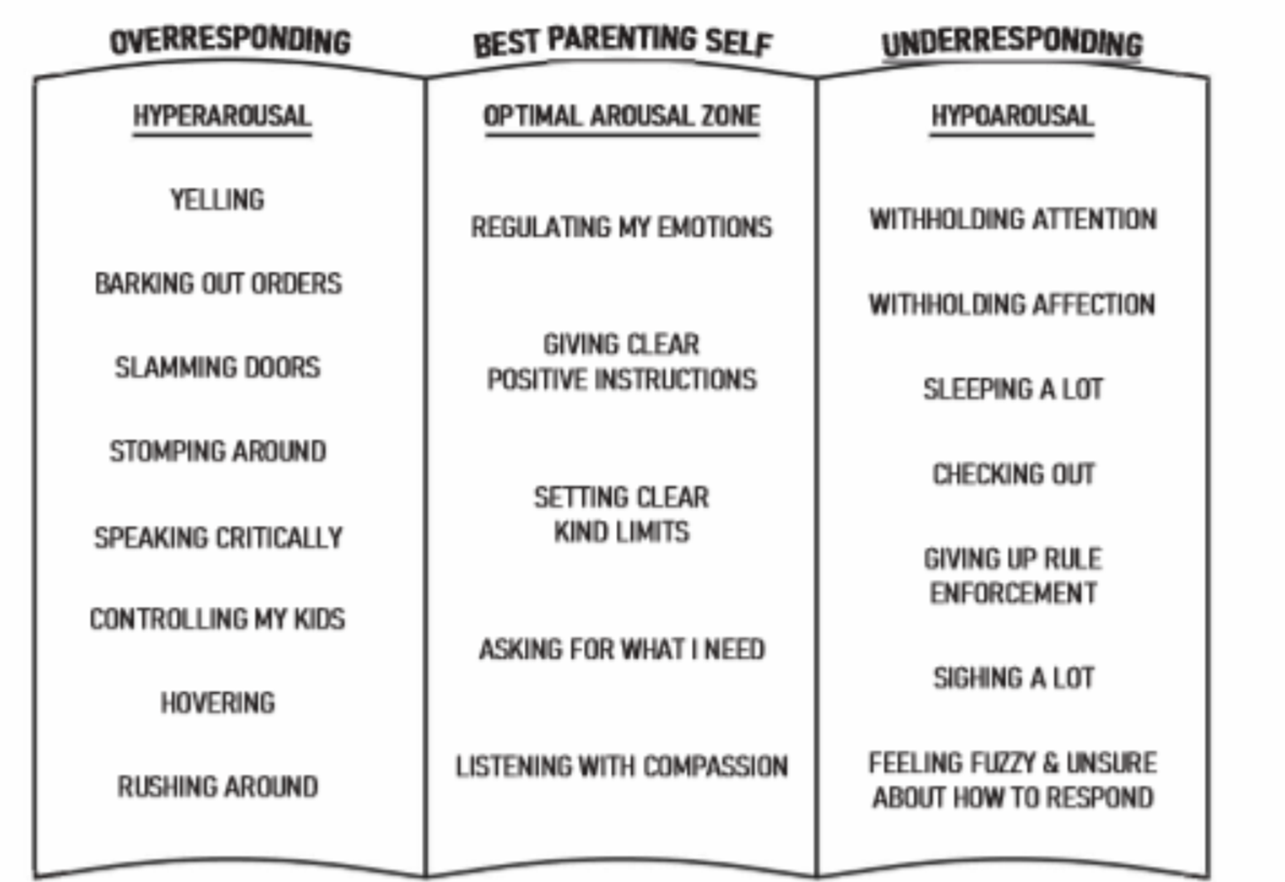
© Paris Goodyear Brown
Notes:
In order for you to be at your best parenting self – it is essential that YOU are ok first. When you are in your optimal arousal zone, you can regulate your emotions, give clear positive instructions.. (read middle section). It feels GOOD to be in this zone, but we all know that we don’t exist there 100% of the time. Do we?
It is possible for every parent/caregiver to slip outside of the zone of optimal arousal into hyper/hypoarousal (read left and right sections). Think about the last time this happened to you – what happened in the leadup to it? The truth is that we are most likely to leave our zone of optimal arousal when we haven’t had time to care for ourselves.

Slide 35
And finally, the Plan/Hope bit
Pen & Paper
Consider your kind of self-care
Create a hope for you
Notes:
Ok so this part is all down to you. We all have priorities, and usually these hover around our children and other people. BUT, for our babies and children to be ok, WE need to be ok. So that priority list might need a reshuffle.
We cant sit here and tell you all to start taking up yoga, or mindfulness or book a spa night away. Because sometimes none of those things can either work for you, or maybe you're just not into them. Maybe your idea of self care is banging drums for 30 minutes, or the idea of a candlelit bath and chill out music sounds like hell!!!
So we want you to take out some paper and a pen or the notes part of your phone, and we’re going to give you 5 minutes to write down 2 or more ideas of your kind of self care.
Now that you’ve done that, we would like you to take another 5 minutes to think about how you could fit one of those things into your life in the next 2 weeks, what's steps you might need to get you there. For example, having a conversation with your partner about minding baby while you watch Housewives of New York for an hour on a Saturday morning. Or arranging a family member to watch your baby while you and your partner go grab a coffee.

Slide 36
A Plan or Hope!
From: Me
To: Me
Notes:
We were going to ask you to make a promise to yourself to try and get your self care factored into your life, but sometimes things dont work out the way you planned.
So instead, see your self care as a hope! And if it doesn't work out this week, try again next week!

Slide 37
Tools in your toolbox
The Nerdy Bit
The Toolbox
A Plan / Hope
Notes:
Recap

Slide 38
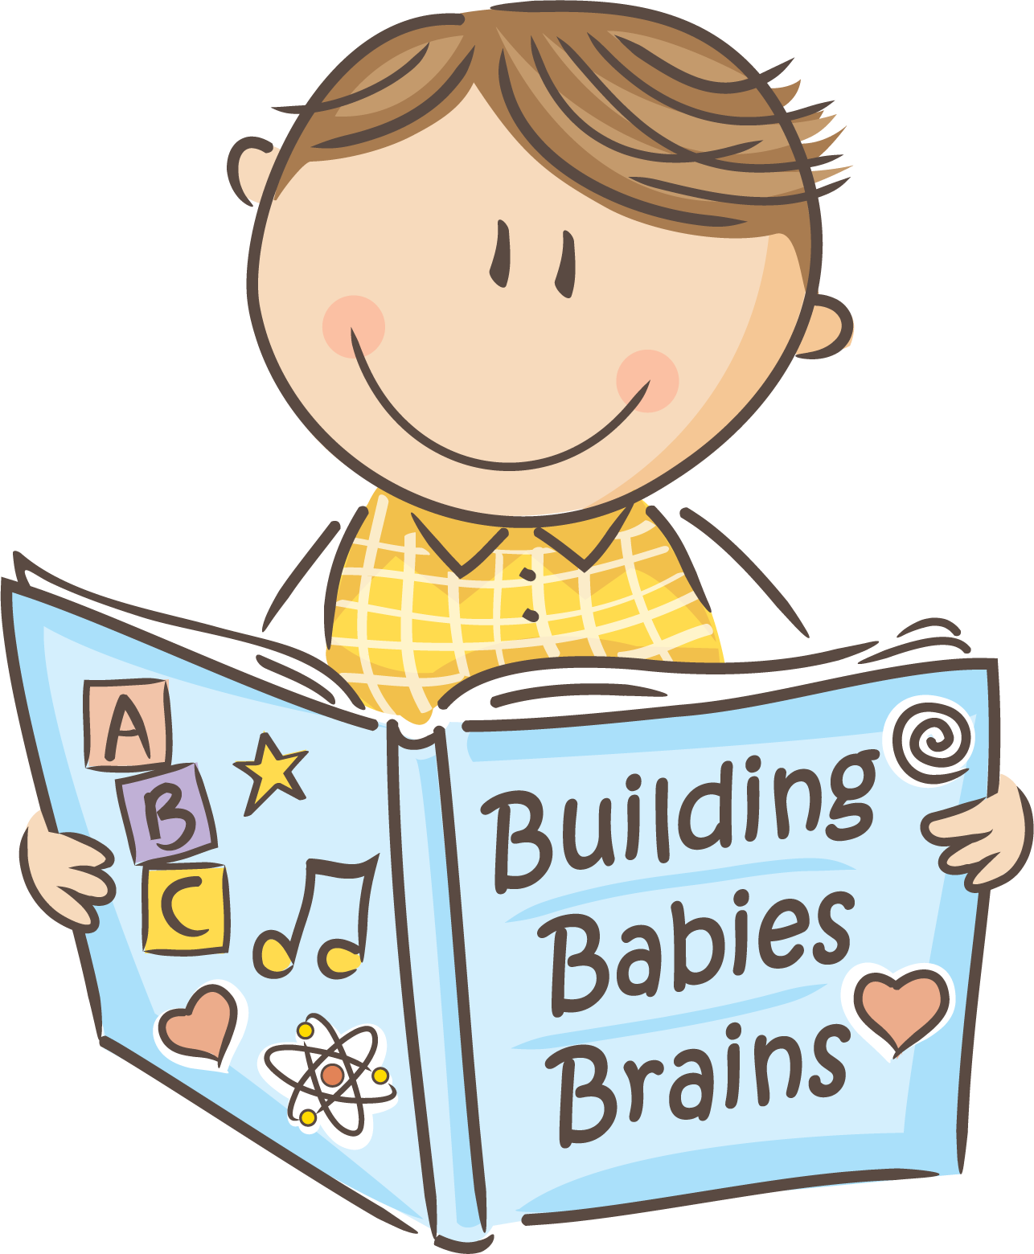
Questions?

